Slide 1



AI in Education
A 2-Days National Level Hackathon
📚 Study Buddy – Chat-First Student-Centric Learning Website
Team DirectX | Leader: Mohnish Singh | SISTec Gandhi Nagar
Notes:
1

Slide 2

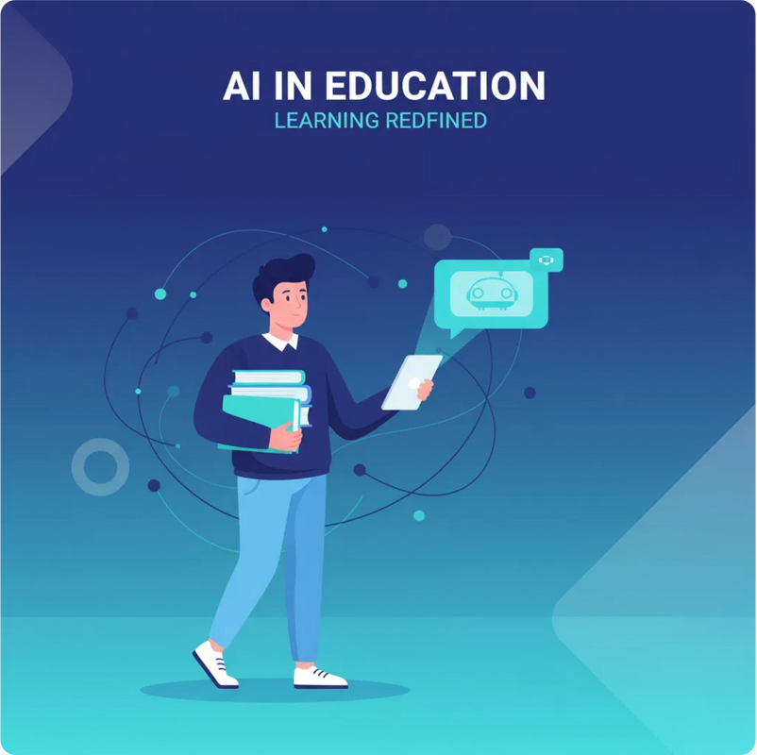
Area Overview
Competitive Exam Preparation Support
Overview:
Preparing for exams like JEE, NEET, CAT, GATE,
and UPSC requires huge amounts of study material, time
management, and reliable updates. Students face scattered
resources, poor personalization, and lack of structured
planning.
Importance:
AI can centralize resources, provide
contextual answers, and personalize study plans, making
preparation smarter and less stressful.
Motivation:
We chose this area because millions of
students in India struggle with exam preparation
inefficiencies. A dedicated AI system can transform this
space by making study material accessible, personalized,
and interactive.
Notes:
2

Slide 3





Challenges & Opportunities
Challenges
Opportunities
Students rely on scattered notes, YouTube, coaching PDFs
AI can unify docs, internet, and curated exam content
No personalized planners aligned to exam + daily routine
Create personalized study plans based on student routines
Limited bilingual support in learning platforms
Make learning bilingual, interactive, and engaging
Static Q&A apps can't adapt to student-specific needs
Support large-scale adoption across multiple exams
Notes:
3

Slide 4

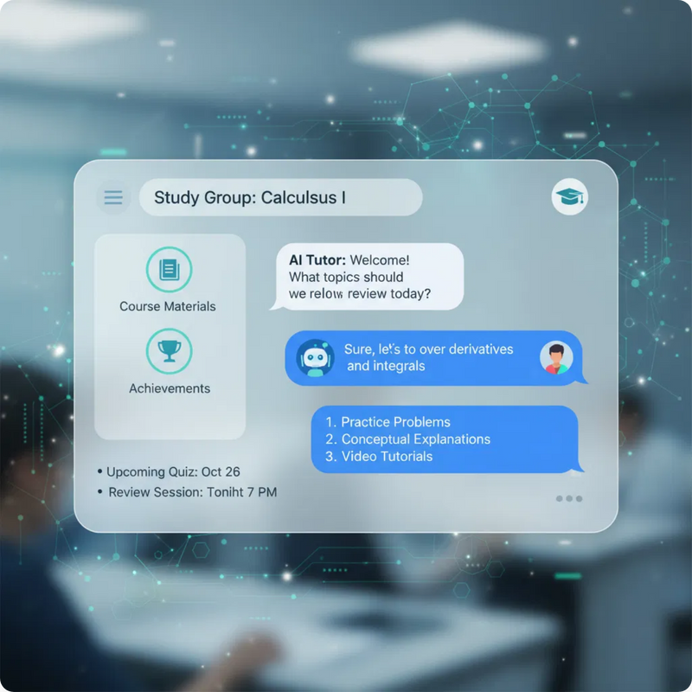




Preliminary Solution Concept
Study Buddy
A chat-first platform (like ChatGPT but student-centric)
One chat window for all study needs
Modes: Docs Mode, Internet Mode, Exam Mode
Personalized onboarding → generates planners and adaptive strategies
Bilingual (English + Hindi), voice & text support
Notes:
4

Slide 5







Key Features & Functionalities
Chat Interface
Docs Support
Student-first UI, intuitive like ChatGPT
Upload PDFs/notes, instant retrieval with OCR/ASR
Internet Search
Exam Knowledge Base
Toggle web integration for fresh updates
Admin-curated PYQs, syllabus updates, notices
Personalized Onboarding
Future Features
Student exam + routine → AI builds study strategies
AI planners, flashcards, mind maps, group study
Notes:
5

Slide 6

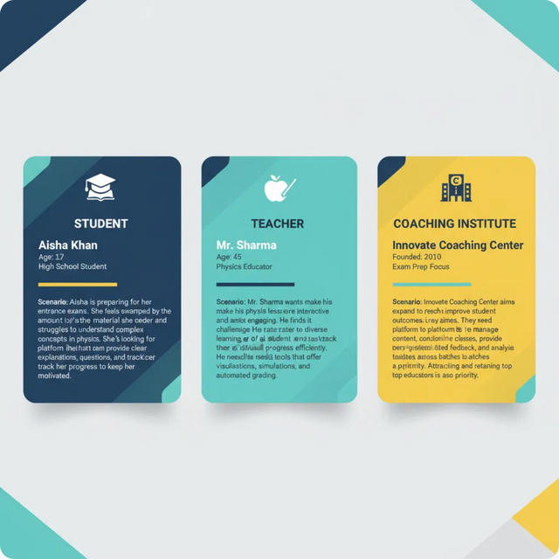



Target Users & Use Cases
Key Use Cases
Student asks: "Make me a 7-day revision plan" → AI builds micro-goals
Student uploads JEE notes → AI generates flashcards
Student toggles Internet → gets latest exam notice with citation
Group of students → AI summarizes and creates peer challenges
Notes:
6

Slide 7





Data & Privacy
Data Requirements
• Uploaded notes and documents
• Previous year papers
• Exam notices and updates
• Personal study routines
Privacy Considerations
Secure student login via Supabase Auth
Data encryption for notes and profiles
Compliance with data minimization
Option to delete uploaded docs anytime
Notes:
7

Slide 8
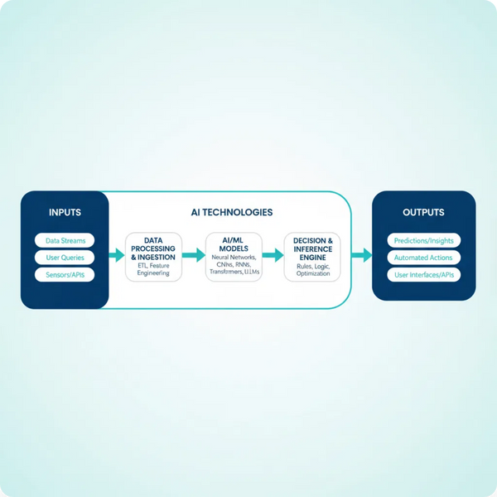





AI Technologies & Methods
NLP:
For contextual chat, multilingual support
Machine Learning:
Personalized planners, adaptive
learning
Vector Search:
Doc & exam content retrieval
OCR & ASR:
Extract text from PDFs, images, audio
(pgvector/Pinecone)
TTS:
Voice-based answers (Azure/Google)
RAG:
Answers grounded in docs/exam base
Notes:
8

Slide 9

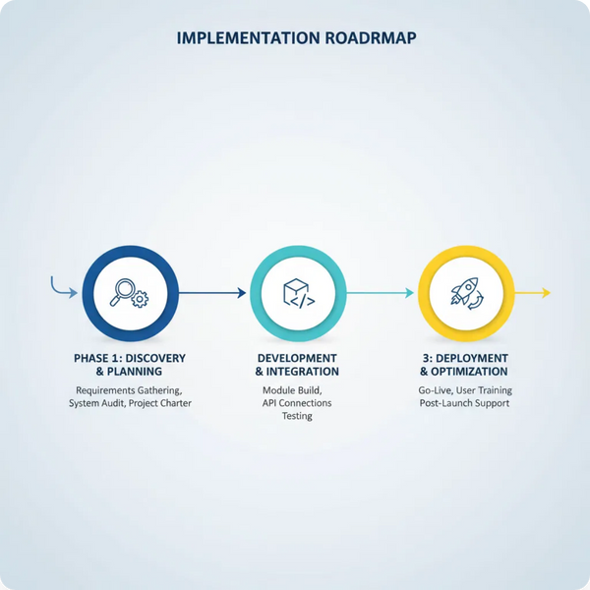



Implementation Approach
Technology Stack
Frontend:
Next.js + Tailwind + shadcn/ui
Backend:
FastAPI / Next.js API routes
Database:
Supabase (Postgres + storage +
LLM Stack:
GPT-4 / Gemini for reasoning
embeddings)
Notes:
9

Slide 10








Evaluation Metrics
Impact on Students
Saves time (centralized resources)
Boosts productivity (personalized plans)
Enhances learning engagement (flashcards, visuals)
Key Performance Indicators
Average response accuracy
Student satisfaction scores
Number of daily active users
Planner adoption & task completion rates
Notes:
10

